Slide 1

Department of Computer Science and Engineering
RVS College of Engineering and Technology, Jamshedpur
Presentation of 7th Semester Project on
LABELCHAIN: A DECENTRALIZED DATA LABELING PLATFORM FOR WEB3
Under the supervision of
Prof. Smita Dash
Presented By:-
Md Nomaan Zeya (CSE/123/21)
Mrityunjay Kumar Gupta (CSE/124/21)
Amar Kant Upadhyay (CSE/125/21)
Anmol Kumar (CSE/126/21)

Slide 2
TABLE OF CONTENTS
Introduction
Problem Statement
Motivation
Literature Survey
Proposed System
Project Workflow
Techniques to Be Used
Work so far
Future Scope
References

Slide 3
INTRODUCTION
Importance: Data labeling is essential for training AI models and ensuring accuracy.
Current Challenges: Centralized systems lack transparency, are costly, and prone to bias.
Project Goal: Build a decentralized platform using blockchain to streamline data labeling.
Focus Areas: Decentralization, security, transparency, and global participation.

Slide 4
PROBLEM STATEMENT
Centralized Control and Bias: Current data-labeling processes are often controlled by centralized entities, leading to potential biases, unfair practices, and lack of accountability. This hampers the quality and fairness of labeled datasets.
Lack of Transparency and Trust: Traditional data-labeling methods lack transparency and verifiability, making it difficult to ensure data integrity and trustworthiness.
Limited Global Participation: Existing platforms often exclude diverse contributors due to accessibility issues, which limits the scalability and inclusiveness of AI training datasets.

Slide 5
MOTIVATION
Transparency: Blockchain ensures verifiable and transparent labeling processes.
Efficiency: Decentralization lowers costs and improves labeling speed.
Global Fairness: Incentivizes diverse participation and reduces bias.

Slide 6
LITERATURE SURVEY
S.No | Title | Year | Author | Methods | Findings/Conclusion
1 | Design and Implementation of Web3-Based E- Commerce Cryptocurrency Payment System | 2023 | Sang-Joon Lee | Web3, Cryptocurrency | Web3 fosters deeper collaboration in online health communities.
2 | Exploring Web3 for Applying to Online Health Community Development Using Text Analysis | 2023 | Sheng-Ming Wang | Blockchain | Decentralization empowers users to control their health data..
3. | Exploring Web3 From the View of Blockchain | 2022 | Qin Wang | Cryptography and Security | Web3 depends on traditional infrastructure.
4. | Crypto Tracking Web Application | 2024 | N. Anusha | Real Time Payment Through Web3 | Web3 integration enhances cryptocurrency tracking.

Slide 7
PROPOSED SYSTEM
Utilize blockchain technology for secure and transparent data labeling.
Implement a token-based system to reward participants for accurate labeling.
Focus on intuitive interfaces to enhance user experience and engagement.

Slide 8
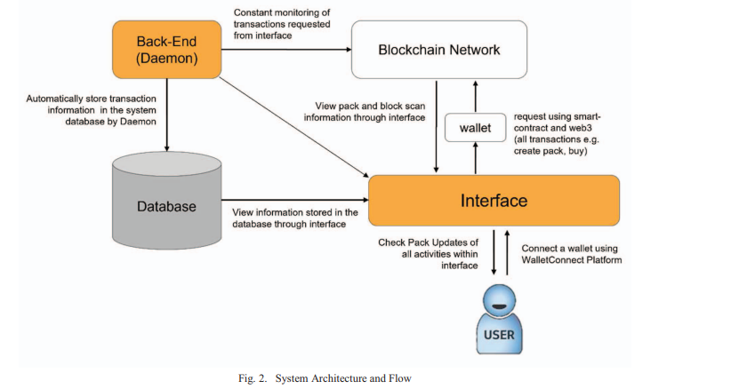
SYSTEM ARCHITECTURE
Fig 4. System Architecture

Slide 9
PROJECT WORKFLOW
User Side Work Flow
User Sign in Through Wallet
Upload Image Based Task Details and Made Payment
Task Will Be Posted on Server
Got All Data Labeling Result
Worker Side Work Flow
Worker Sign in through Wallet
Check Any Task is available to do
Perform If any Tasks are Available
Withdraw their respective Money Earned in Wallet

Slide 10
TECHNIQUES TO BE USED
Backend: Node.js, Express.js
Blockchain: Solana (Web3.js)
Cloud Storage: AWS S3 with pre-signed URLs for asset management
Database: PostgreSQL for task and user management
Frontend: React, Redux
Authentication & Wallet: Phantom Wallet for cryptocurrency transactions
Security: Best practices for private key management and secure transaction handling

Slide 11
Work So Far
Literature Survey
User Front End
Web 2 Backend Developement
Worker Front End
Web 3 Backend Developement
All Wallet Setup with Live Transaction

Slide 12
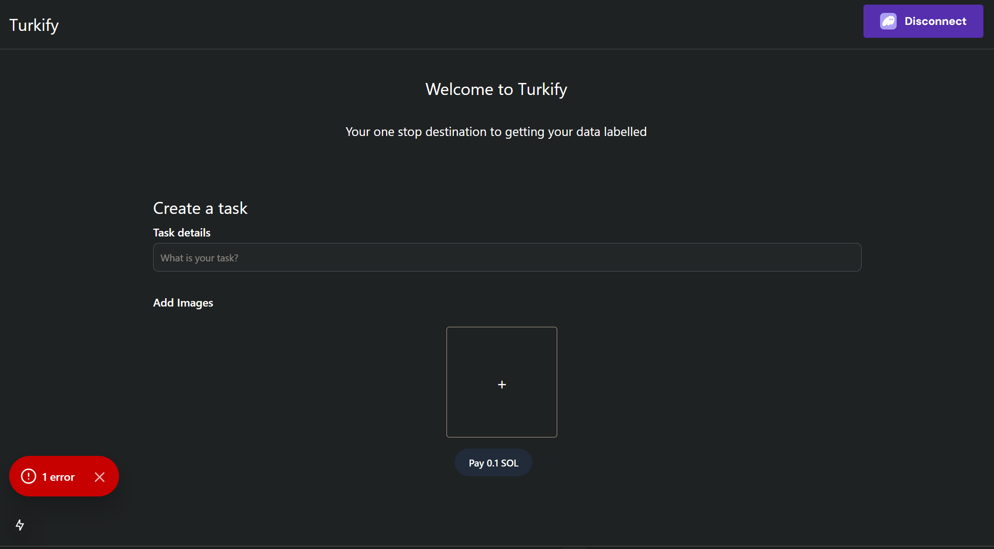
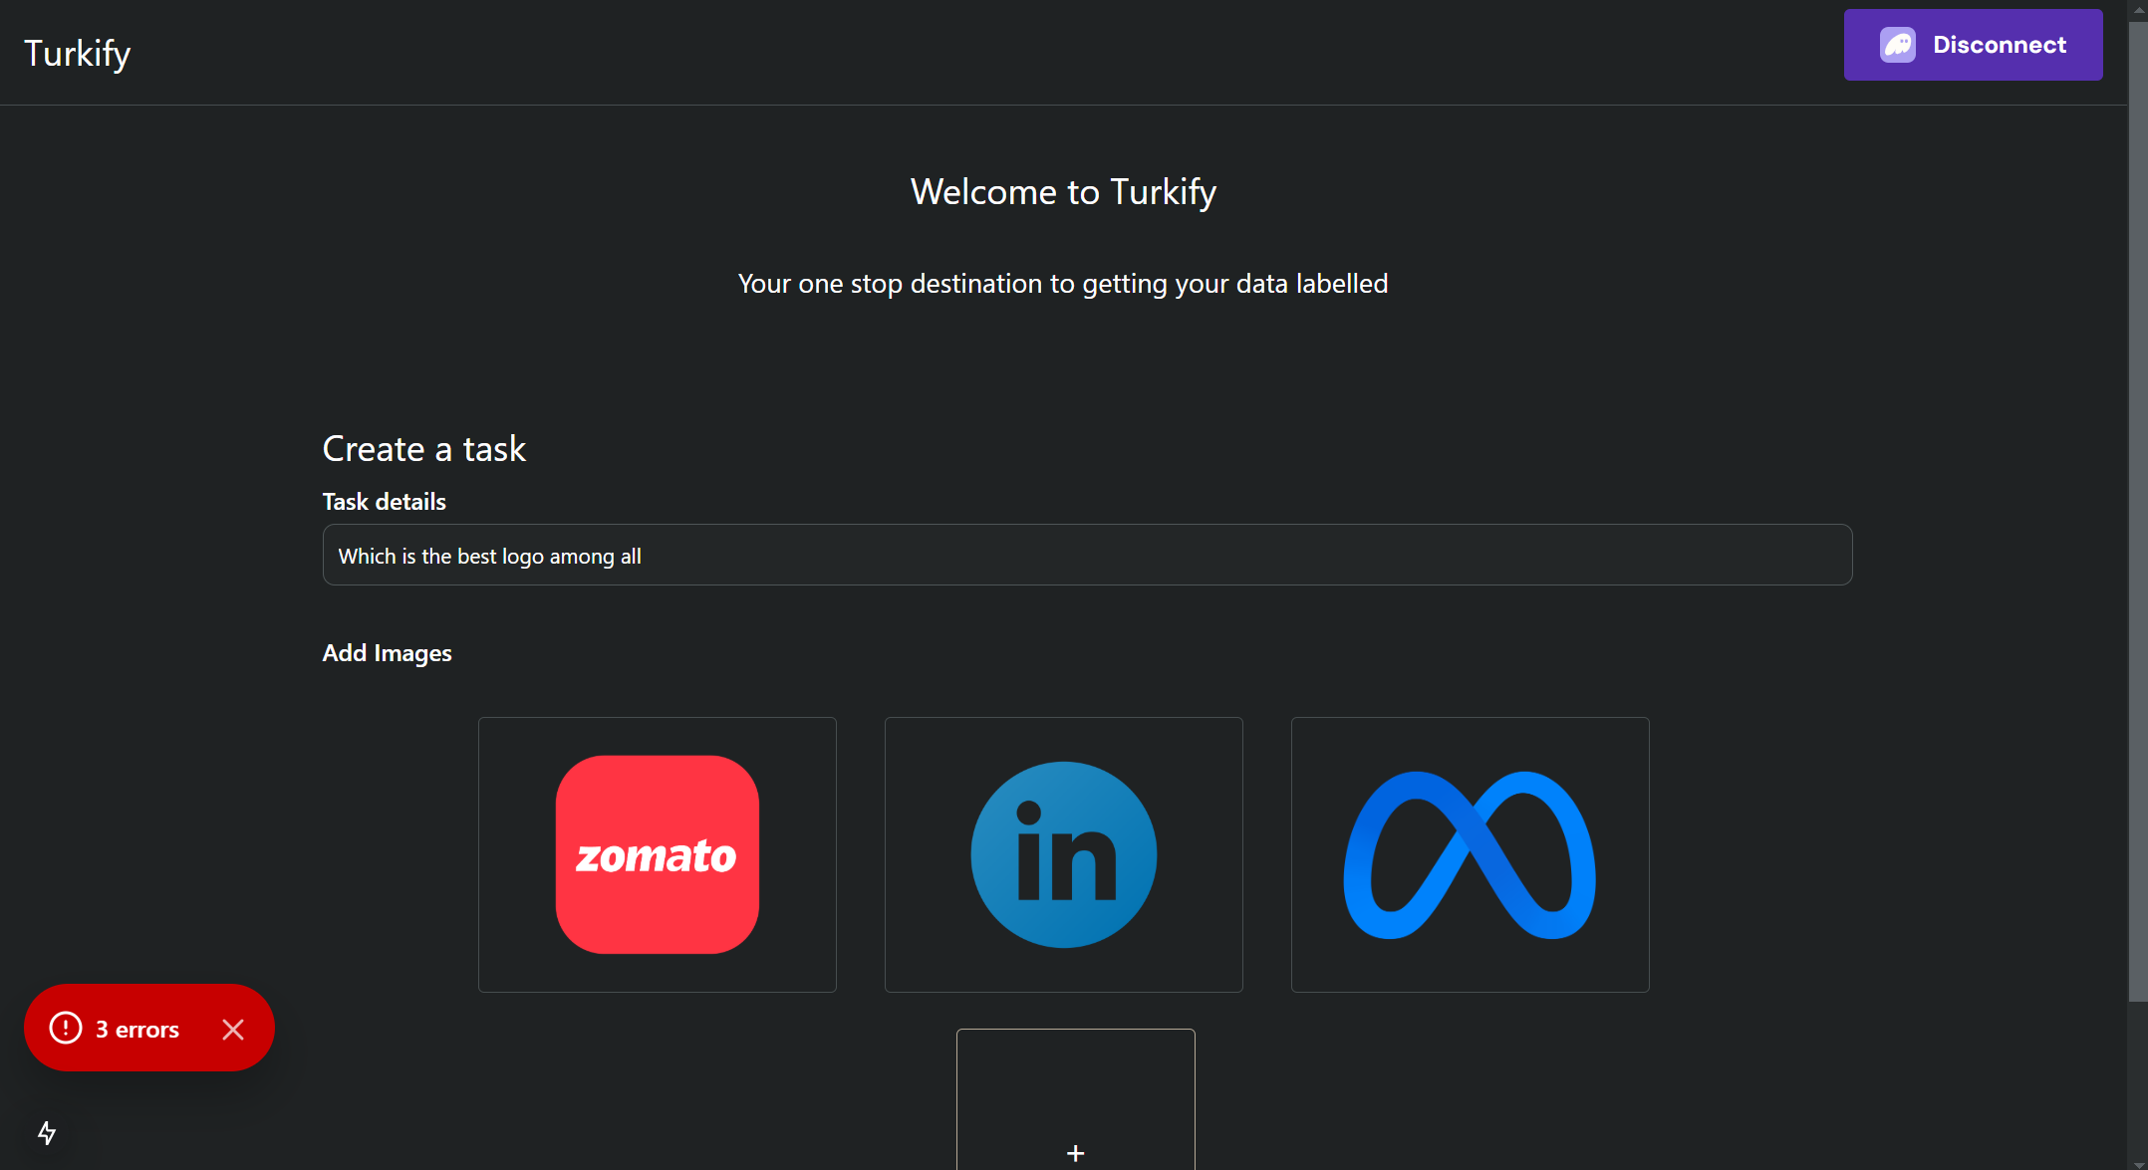
1.User UI
Work So Far
Fig 1. User UI with Task Details Submission Page

Slide 13
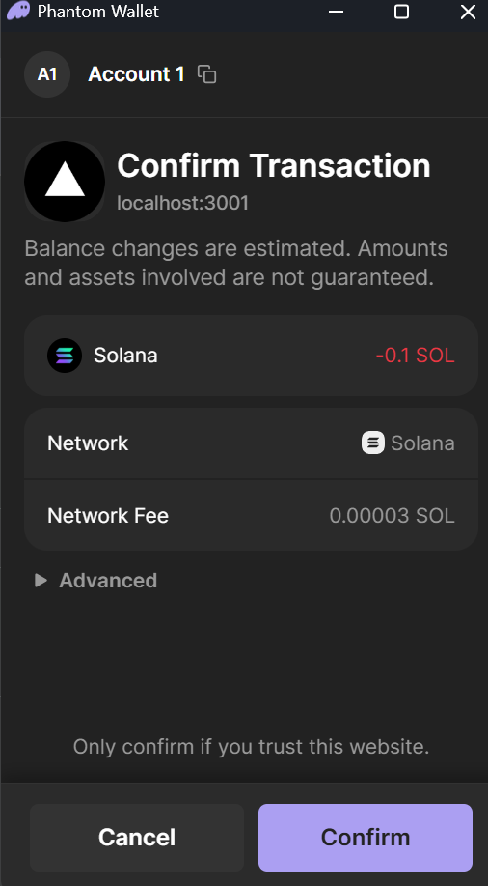
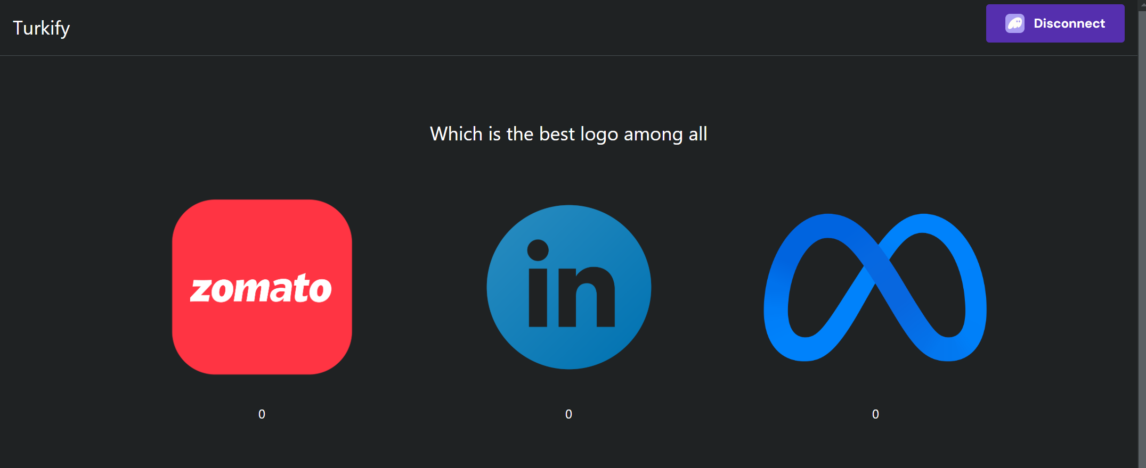
2. Payment Done By User And Task Details User
Work So Far
Fig 3. Task Details Displayed
Fig 2. Payment Confirmation By User

Slide 14
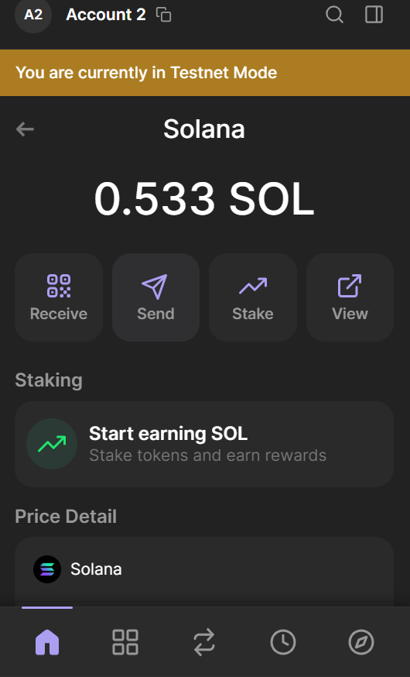
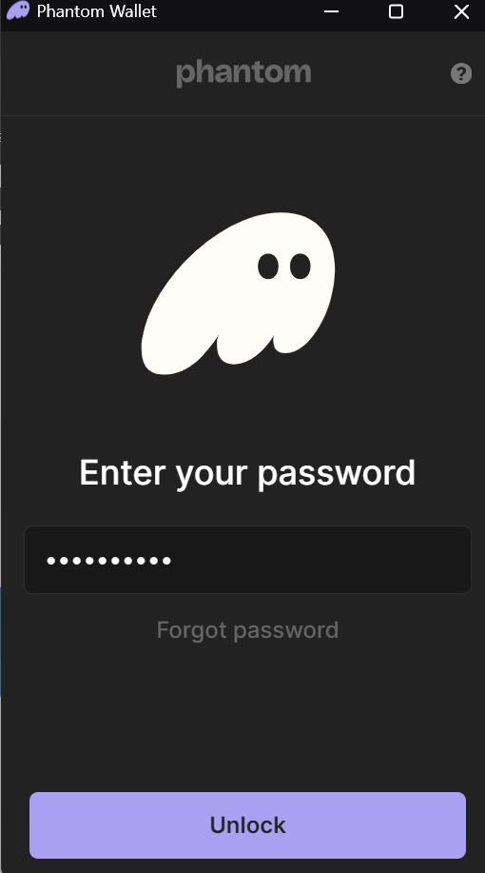
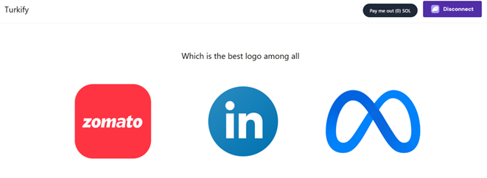
WORK SO FAR
3. Worker Frontend
Fig 5. Task Displayed on Worker Side
Fig 4. Worker Sign in
Fig 6. Payment Deposited to Worker Account

Slide 15
FUTURE SCOPE
Support for Multiple Blockchains.
AI Tools for Faster Labelling.
Rewards for Participation with Tokens.

Slide 16
REFERENCES
[1.] "AWS S3 Storage and Pre-Signed URLs," AWS Documentation
[2.] "Phantom Wallet Integration with Solana," Phantom Wallet
[3.] "Blockchain and Web3.js," Web3.js Documentation
[4.] "Best Practices for Private Key Management," OWASP Security Practices
[5.] " Solana Blockchain Developer Guide", Solana Dev Guide
[6.] "Node.js Express.js Express.js Documentation", Express.JS Guide

Slide 17
THANK YOU

